Slide 1

Role_revolve
The database for the movies

Slide 2

Abstract
Role Revolve is a dynamic project redefining the way we experience and appreciate the world of cinema. This innovative platform offers a comprehensive database, bringing together artists, directors, movies, casting details, and user reviews. Dive into the captivating world of films, explore artist profiles, unravel casting decisions, and engage with fellow enthusiasts. Role Revolve is not just a resource; it's a celebration of storytelling through the magic of movies. Join us on this cinematic journey where roles revolve, stories unfold, and the art of film takes center stage.

Slide 3
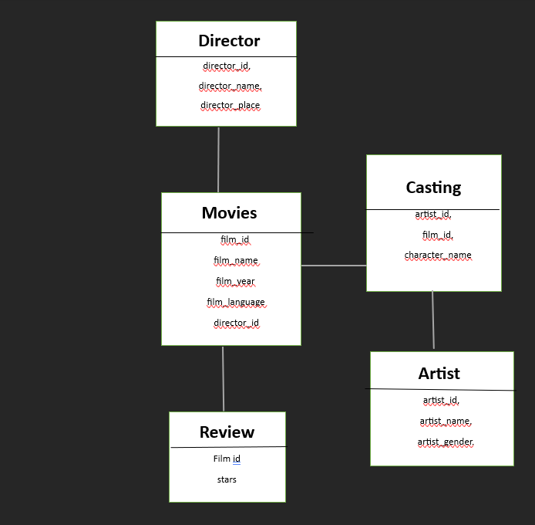
ER Diagram

Slide 4
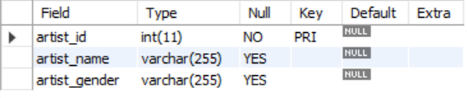
Structure of table
Artist table:
Meet your favorite actors and actresses! This table holds their names and genders, helping you explore who's behind the scenes in every film.

Slide 5
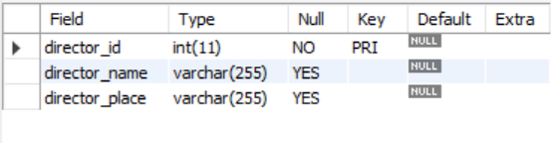
Structure of table
Director table:
Discover the masterminds shaping your favorite movies. Get to know directors by their names and where they're from, connecting you to the creative minds in the industry.

Slide 6
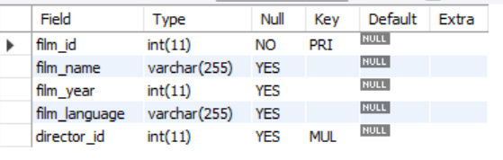
Structure of table
Movie table:
Dive into the world of cinema! This table showcases movies with details like names, release years, and languages, making it easy for you to find the perfect film.

Slide 7
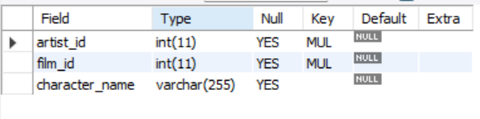
Structure of table
Casting table:
Uncover the perfect cast for every movie. See who plays what role with character names, connecting you to the heart of each story.

Slide 8
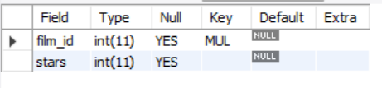
Structure of table
Review table:
Share your thoughts on movies! This table collects user reviews and star ratings, giving you a user-friendly guide to the best films based on community feedback.

Slide 9
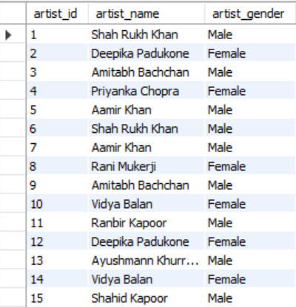
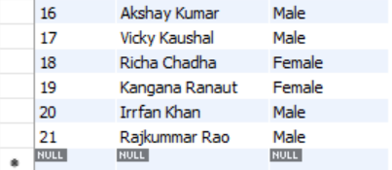
Content of table
select * from artist;

Slide 10
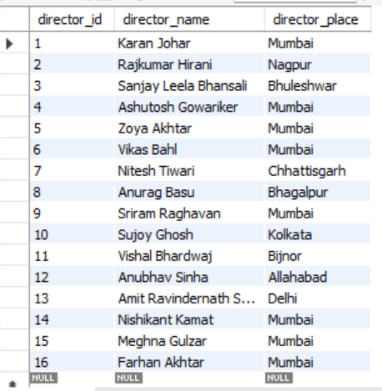
Content of table
Select * from director

Slide 11
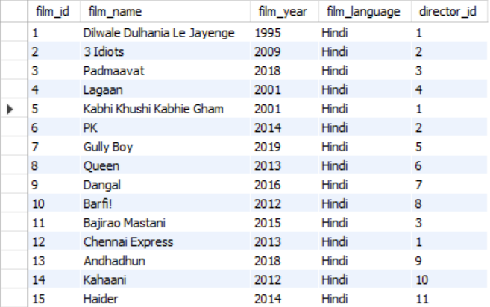
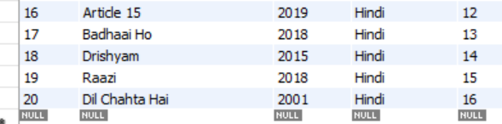
Content of table
Select * from movie;

Slide 12
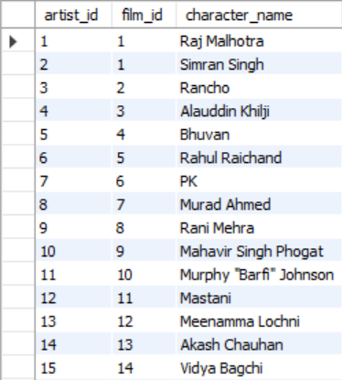
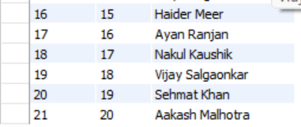
Content of table
Select * from casting;

Slide 13
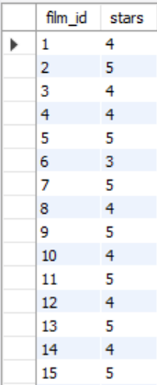
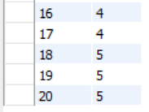
Content of table
Select * from review;

Slide 14

JOins

Slide 15
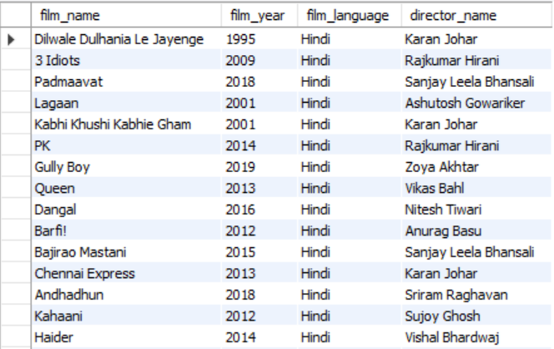
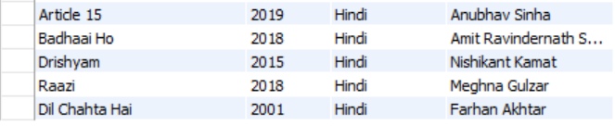
1. retrieve movie details along with the corresponding director names from the database:
SELECT movie.film_name, movie.film_year, movie.film_language, director.director_nameFROM movieINNER JOIN director ON movie.director_id = director.director_id;

Slide 16
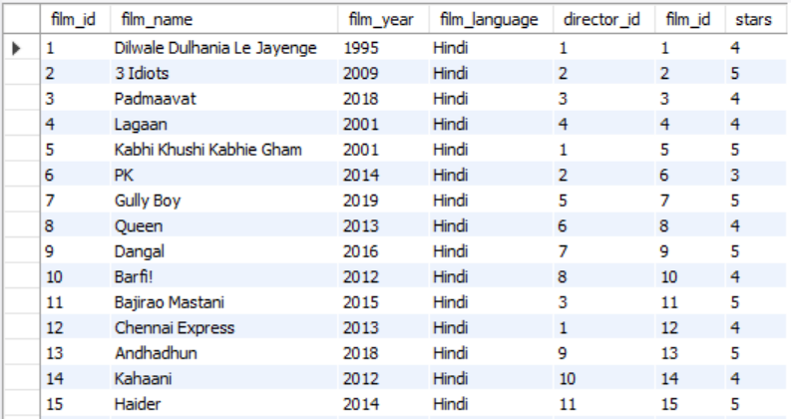
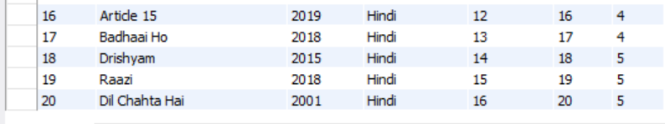
2. retrieves all movies and their review ratings
SELECT *FROM movieLEFT JOIN review ON movie.film_id = review.film_id
UNION
SELECT *FROM movieRIGHT JOIN review ON movie.film_id = review.film_id;

Slide 17
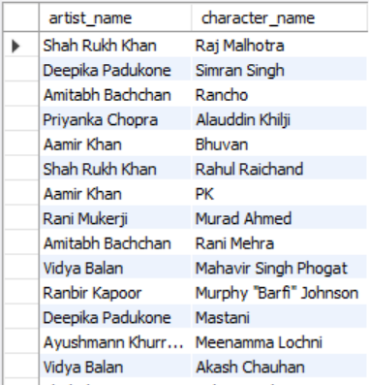
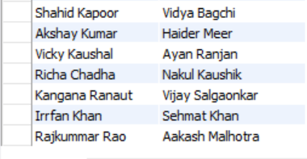
3. all artists, along with the characters they have played in movies.
SELECT artist.artist_name, casting.character_nameFROM artistLEFT JOIN casting ON artist.artist_id = casting.artist_id;

Slide 18
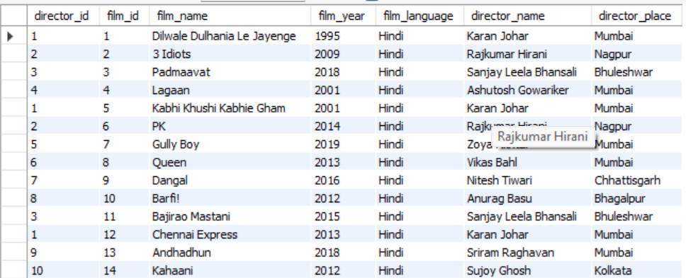
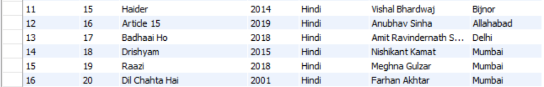
4. all movies along with their details and the corresponding directors
SELECT *FROM movie NATURAL JOIN director;

Slide 19
Subqueries

Slide 20
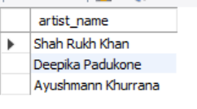
Find Artists Who Have Acted in Movies Directed by Karan Johar:
SELECT DISTINCT artist_nameFROM artistWHERE artist_id IN ( SELECT artist_id FROM casting WHERE film_id IN ( SELECT film_id FROM movie WHERE director_id = (SELECT director_id FROM director WHERE director_name = 'Karan Johar') ));

Slide 21
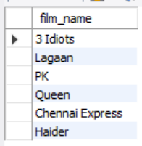
2. Find Movies Where at Least One Actor Has a Name Starting with 'A’:
SELECT film_nameFROM movieWHERE EXISTS ( SELECT 1 FROM casting INNER JOIN artist ON casting.artist_id = artist.artist_id WHERE casting.film_id = movie.film_id AND artist.artist_name LIKE 'A%');

Slide 22
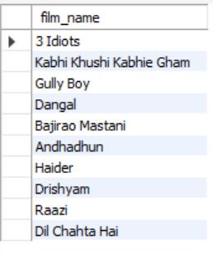
3. Find Movies with the Highest Rating:
SELECT film_nameFROM movieWHERE ( SELECT MAX(stars) FROM review WHERE review.film_id = movie.film_id) = 5;

Slide 23
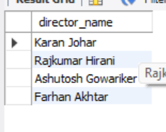
4. Find Directors Who Have Directed Movies Released Before 2010:
SELECT director_nameFROM directorWHERE EXISTS ( SELECT 1 FROM movie WHERE movie.director_id = director.director_id AND film_year < 2010);

Slide 24
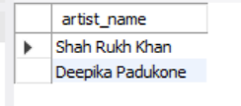
5. Find Artists in the Movie "Dilwale Dulhania Le Jayenge":
SELECT artist_nameFROM artistWHERE artist_id IN (SELECT artist_id FROM casting WHERE film_id = (SELECT film_id FROM movie WHERE film_name = 'Dilwale Dulhania Le Jayenge'));

Slide 25
queries

Slide 26
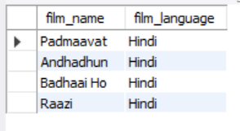
Retrieve movies released in a specific year:
SELECT film_name, film_languageFROM movieWHERE film_year = 2018;

Slide 27
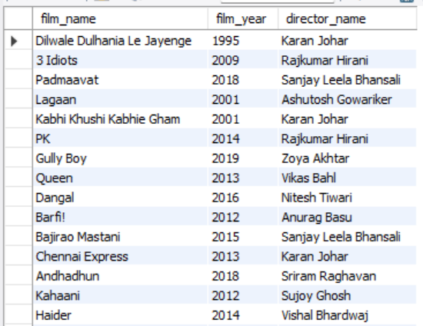
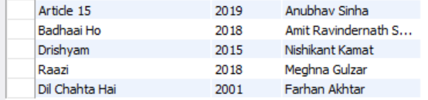
2. Retrieve all movies and their directors:
SELECT movie.film_name, movie.film_year, director.director_nameFROM movie, directorWHERE movie.director_id = director.director_id;

Slide 28
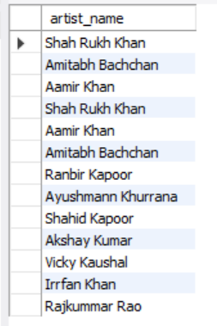
3. retrieve all the male actors form the table artist
SELECT artist_nameFROM artistWHERE artist_gender = 'Male';

Slide 29
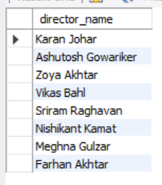
4. Retrieve directors from Mumbai
SELECT director_nameFROM directorWHERE director_place = 'Mumbai';

Slide 30

PREPARED BY:
KARINA RAJU KADAM
PREPARED BY:
KARINA RAJU KADAM
IT VEDANT

Slide 31


